Slide 1
Gradient Boosting

Slide 2
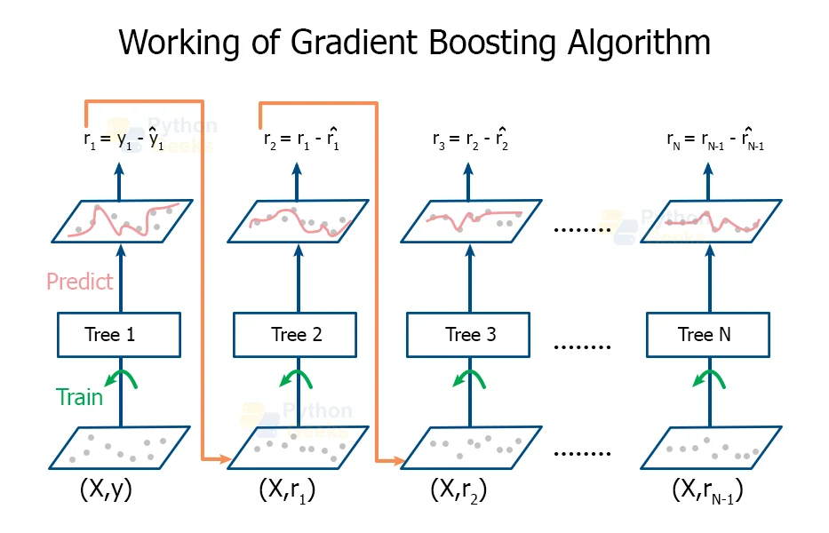
Working of Gradient Boosting:

Slide 3
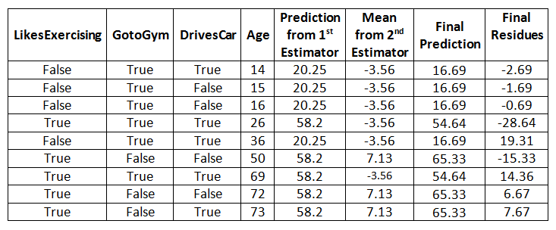
Sample Table:
In Gradient Boosting, the Mean and Residue of predicted variables will be calculated on each tree.
Residue will be less on final tree where we will get good model.

Slide 4
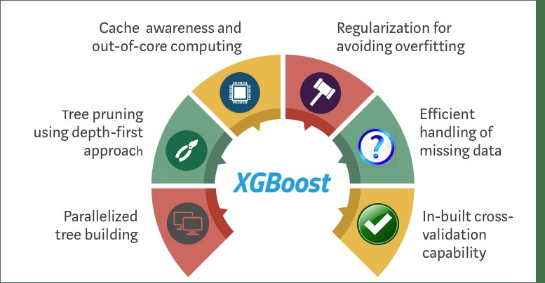
XG Boosting.

Slide 5
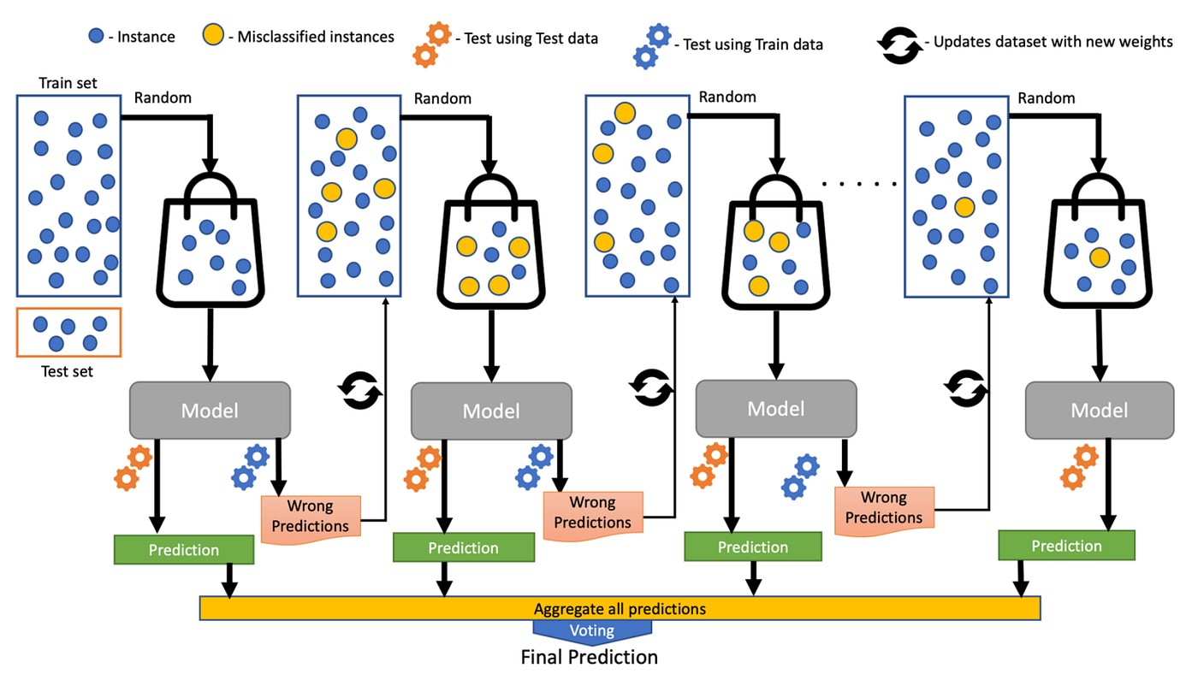
Working of XG Boosting:

Slide 6
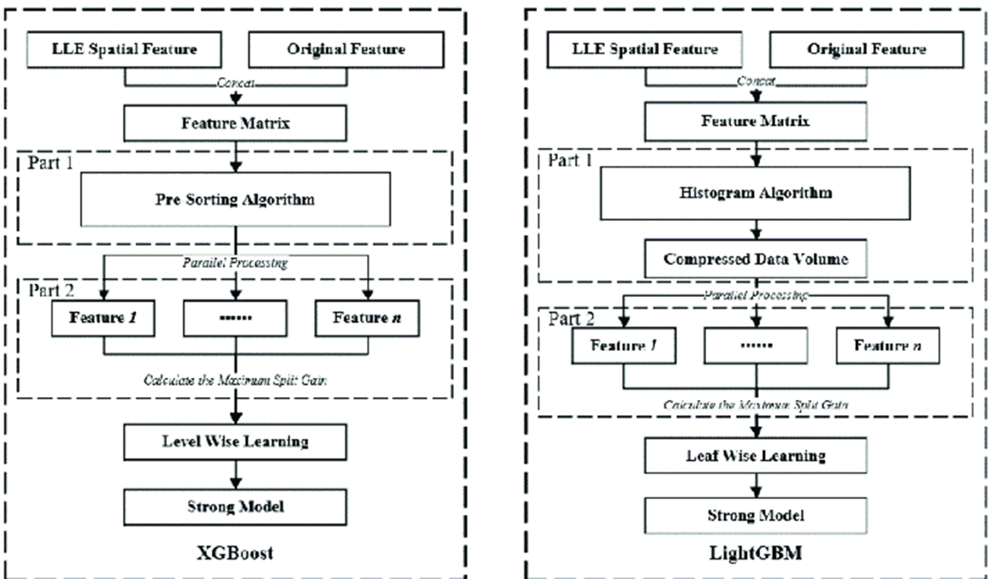
Difference between XG and LG Boosting:

Slide 7
